Slide 1

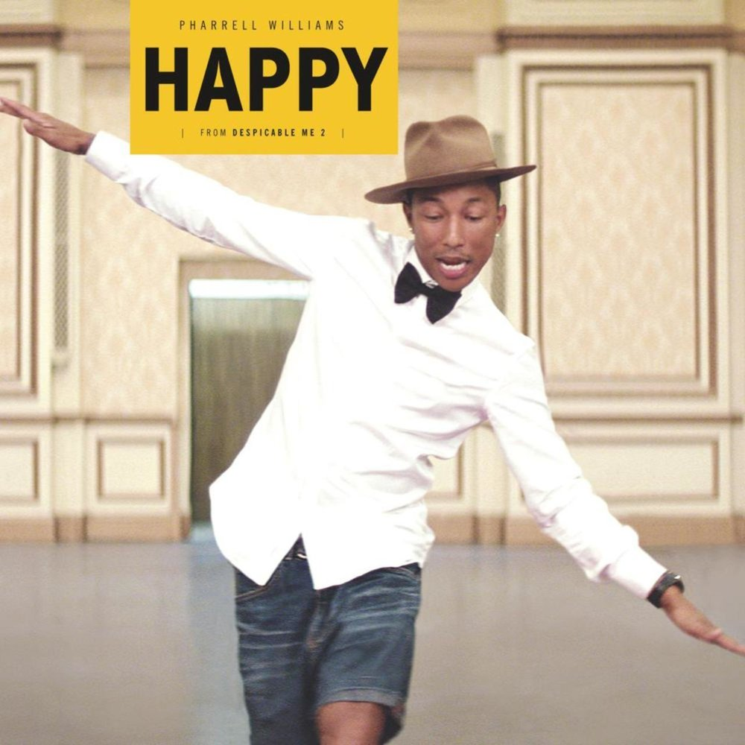
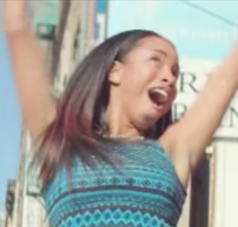
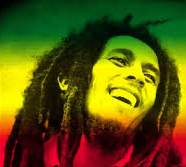
Developing Emotions Week 8. Lesson 1 Top Tunes!

Slide 2
Top Tunes
Today we’re thinking about music and lyrics and how they express joy and happiness!
We’re going to start with a famous song that is just called ‘Happy’. You might recognize it.
It is pretty catchy so you might find it hard to get it out of your head for the next couple of days. Sorry!

Slide 3
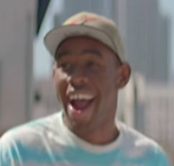
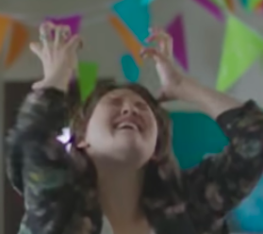
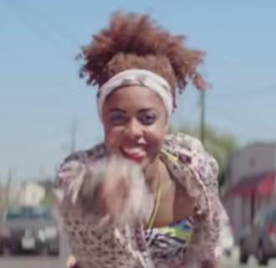
Words for Joy
In a minute we are going to try to describe the emotions that the people in the music video are expressing.
List as many different words for happy feelings as you can while the video is playing.

Slide 4

Click below to watch the video of ‘Happy’ by Pharrell Williams

Slide 5
Clap along if you feel like…
Can you spot any similes or metaphors in the lyrics of ‘Happy’?
Circle any you can find on page 55 of your books.
What does happiness feel like? A room without a roof? Something else?
Great tune! Now let’s think about the lyrics.
First – who knows what a simile is? And a metaphor?

Slide 6

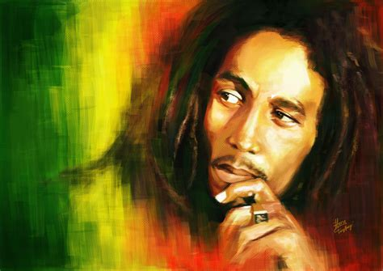
Now click for some more music….
Does anyone know what kind of music this is?
Or the name of the singer?
How does this song make you feel?
Does it make you feel like dancing?

Slide 7
Time to learn more about reggae…
Turn to page 56 and then read the following slides carefully.
They will help you fill in your Reggae Music Fact File.

Slide 8
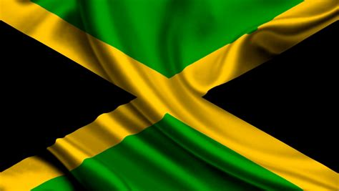
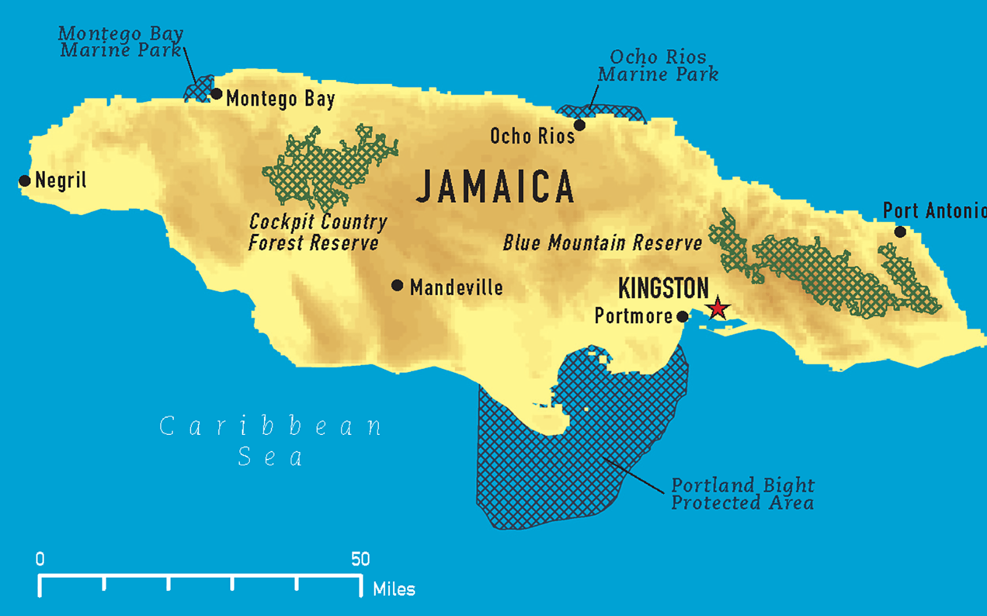
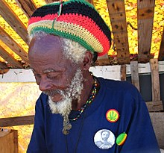
From Kingston Town to Notting Hill
The Story of Reggae
Reggae came from Jamaica, in the West Indies, in the late 1960s.
The capital of Jamaica is Kingston.
Reggae is linked with a religion called Rastafari or Rastafarianism.
The Rastafari colours are green, gold, red and black.
The song you heard earlier was ‘One Love’ by Bob Marley.
Another of his hits was ‘Redemption Song’.

Slide 9
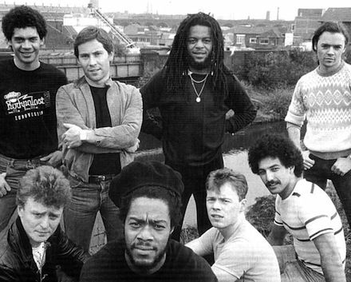
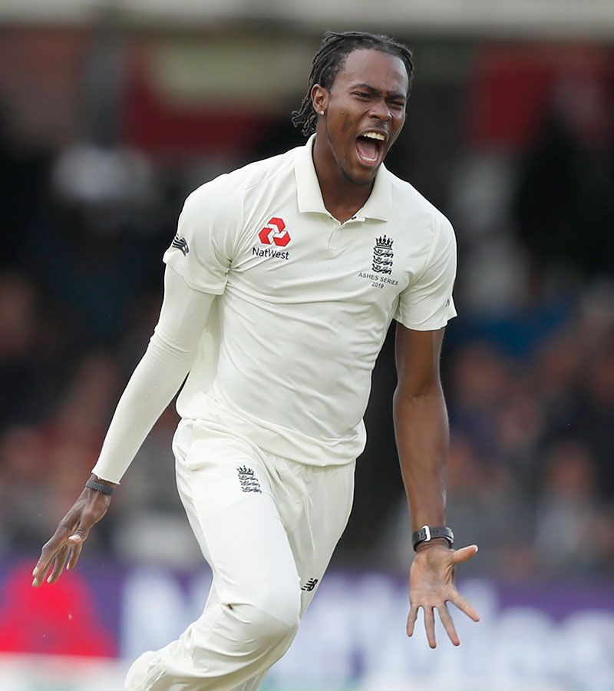
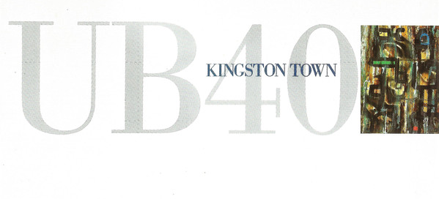
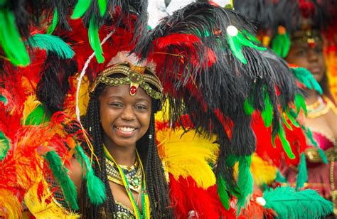
From Kingston Town to Notting Hill
The Story of Reggae
Modern Britain has been made happier by Jamaica and the West Indies in many ways.
One of the most successful reggae bands in the UK was UB40.
Their songs included one about the capital of Jamaica, ‘Kingston Town’.
The Notting Hill Carnival first took place in 1966.
It is led by the British West Indian community and attracts about one million people.

Slide 10
Words for Joy
Music and sport can make us feel happy and joyful.
How many different words do you know for happy feelings?
Check the list on page 51 to see if you know all the words there.
Now we are going to learn the original, historical meanings of some of them.

Slide 11
Match the word to its original meanings!
1. Happy
2. Joy
3. Pleasure
4. Contentment
Literally, a jewel – delight and wonder
Taking enjoyment through your senses (sight, taste, touch)
A feeling of all your needs being met: a total absence of worry
Lucky, fortunate, having a good life

Slide 12
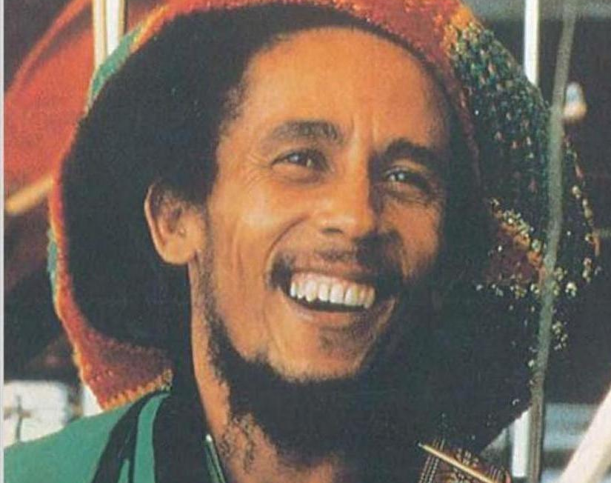
Don’t forget to take the Happiness Quiz on page 57!

Slide 13

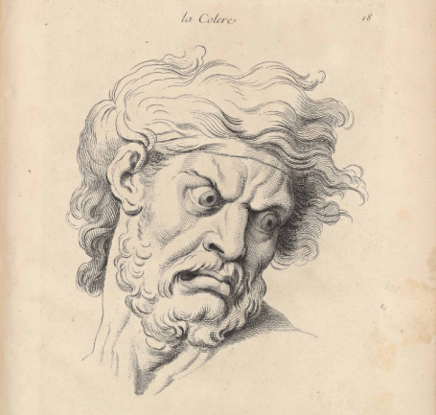
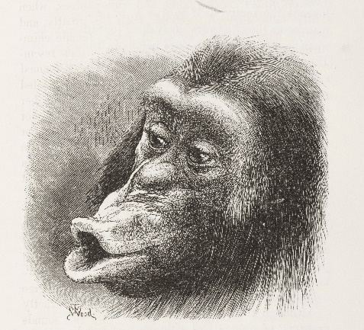

Developing Emotions Week 8. Lesson 2 Conclusions

Slide 14


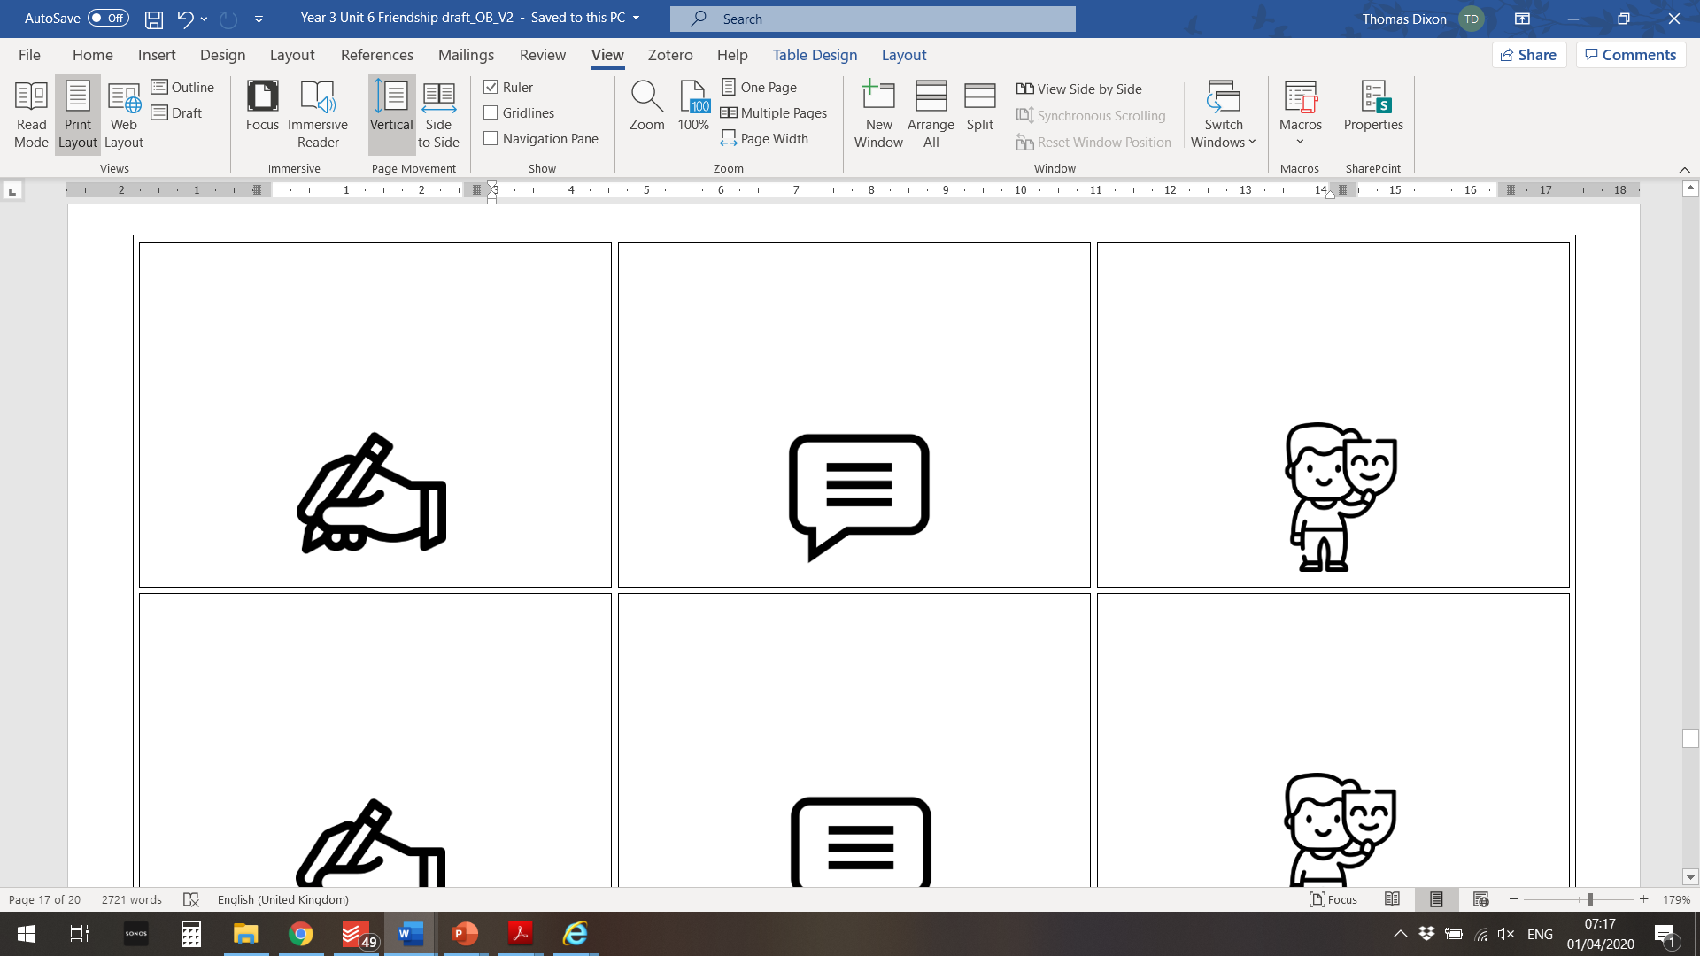
Developing Emotions
This is the last lesson of Developing Emotions.
We’re going to play a game called Emotionology!
Then we will take some quizzes to show how much we have learned about feelings and emotions.
At the end you will receive a certificate because you are now an expert on emotions!

Slide 15
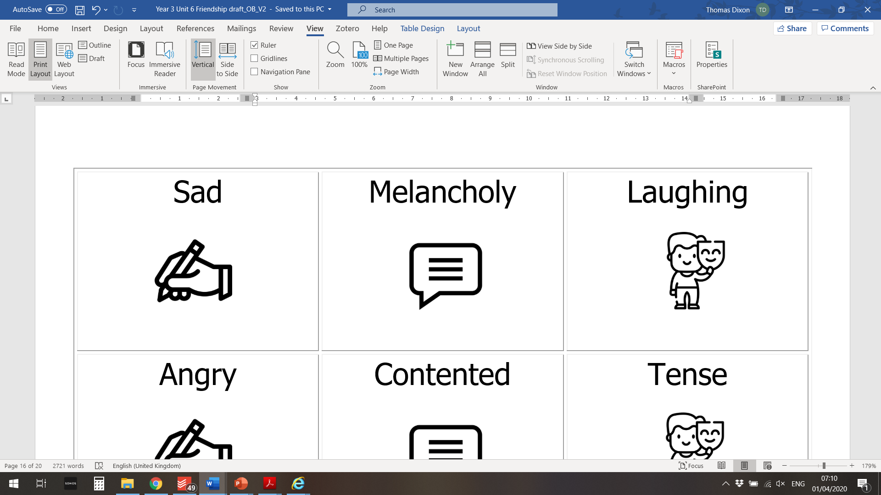
Let’s play EMOTIONOLOGY – The Game of Feelings!
In this game you are going to draw, describe, or act out different feelings and emotions for your team-mates to guess.
But first, we need to prepare the materials.
On your table you have a set of cards which each have a heart symbol on the back.
Some have emotion words and symbols written on them like the ones on this slide.

Slide 16
Let’s play EMOTIONOLOGY – The Game of Feelings!
Some of the cards are blanks - they have a symbol but no word – like the ones pictured here
Share the blanks out in your group and write a word for an emotion or feeling on each one.
It could be something simple like happy or something more unusual, like petrified, ecstatic, or raging.

Slide 17
Let’s play EMOTIONOLOGY – The Game of Feelings!
Now your emotion cards are ready.
Place them all in a single pile, face-down.
In your group, each player will take a turn to take a card from the top of the pile. Don’t show your card to anyone else! And don’t say the word!
Then you have to describe draw or act out the word on your card.
If you don’t know the word, that’s fine – just put it to the bottom of the pile and take another one!

Slide 18
Let’s play EMOTIONOLOGY – The Game of Feelings!
When an emotion is guessed correctly, it’s the next person’s turn to take a card and have a go.
Ready to play?
When your teacher says ‘Go!’ you will have five minutes to guess as many emotion words as possible.
Go!!

Slide 19
Let’s play EMOTIONOLOGY – The Game of Feelings!
Which group guessed the most emotion words?
Were some particularly tricky?
Was it easier to describe, draw, or act out the emotions?

Slide 20
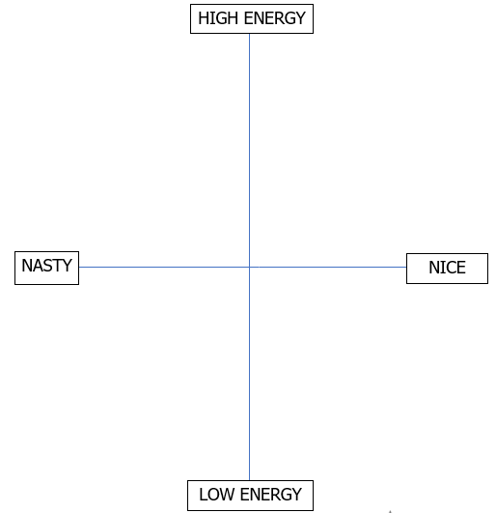
Mapping our emotions
Now we are going to place our emotion words on a map like this one:
For each word you need to decide where it fits on the map.
Does it feel nice or nasty?
Is it high energy or low energy?

Slide 21

Mapping our emotions
The nicer the feeling, the further to the right it should go…
…the nastier the feeling, the further to the left.
More energetic ones go higher up, and ones with no energy go lower down.
In the centre is Meh!
We’ve added some words as examples
Delighted
Annoyed
Sad

Slide 22
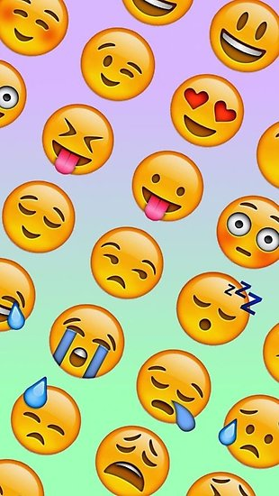
Final quizzes
Now you have finished the
Developing Emotions
lessons, it is time to take two final quizzes to see what new words and feelings you have learned!

Slide 23
Conclusions
We hope the Developing Emotions lessons have been fun and that you have learned a lot!
You have seen that there are hundreds of different emotions!
We can express them in words, actions, music, movement, colours and images.

Slide 24
Conclusions
A happy life is full of laughter, joy, and friendship…
…but there’s room for other emotions too, like sadness or worry, which we will all sometimes feel.
Learning to name our feelings can help us celebrate them… and also to control and understand them.

Slide 25

Thank-you for completing these lessons!
You are now a certified emotional expert
Congratulations!

